Slide 1
SAP EWM EXTENDED WAREHOUSE MANAGEMENT TRAINING
AnubhavTrainings.com
www.anubhavtrainings.com

Slide 2

SAP EWM TRAINING
BY:-
Mr. Bijoy
www.anubhavtrainings.com
Notes:
https://unsplash.com/photos/uXB-7la5vqA

Slide 3
SAP EWM TRAINING (Day 05)
AnubhavTrainings.com

Slide 4
ERP S4 - EWM Integration & EWM Master data
Connecting ERP to EWM
SAP EWM control parameters
Assigning ERP Warehouse to EWM warehouse
Assigning SCU & BP
Define Storage types, Storage type controls, Define Storage sections, Storage Bins Configuration, Define Staging areas & Doors, Define Activity areas, Stock types, EWM Product master data

Slide 5
EWM HU MANAGEMENT
Contents
ERP side Configuration
Define packaging material types
Define material group for packaging materials
Define Allowed Packaging Materials
Define number range for HU & Assign Number range to Pack. Material grp

Slide 6
EWM HU MANAGEMENT
Contents
EWM side Configuration
Define packaging material type
Maintain allowed packaging material type for packing group
Define HU type
Define HU type group
Define HU type for each warehouse number & assign HU type group
Define HU type for each storage type
Define number range for HU & Assign Number range to Pack. Material grp

Slide 7
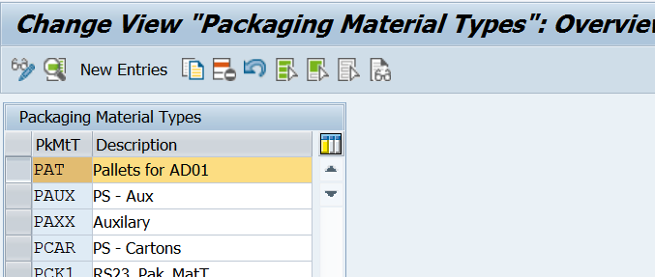
Define packaging material types
IMG --> Logistics general --> Handling Unit management --> Basics > First 3 nodes

Slide 8
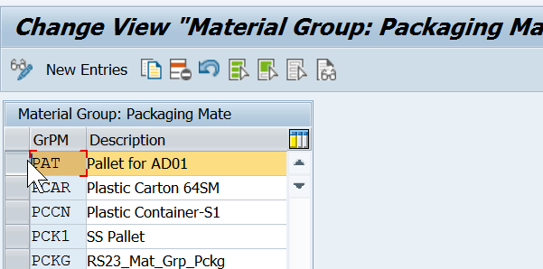
Define material group for packaging materials
Groups together materials that require similar packaging materials.

Slide 9
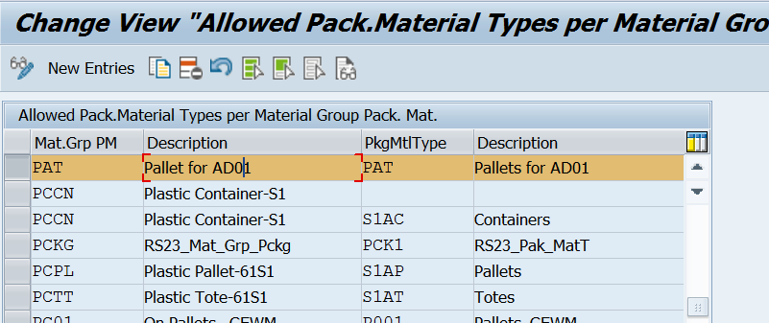
Define Allowed Packaging Materials
Simple example of this assignment
Material group for packaging materials Packaging material types
0001 Beverages 0010 Barrels
0001 Beverages 0020 Bottles
0002 Small parts 0030 Boxes
0002 Small parts 0040 Plastic bags
0003 Pallets 0050 Containers
0003 Pallets 0060 Trucks
www.anubhavtrainings.com

Slide 10
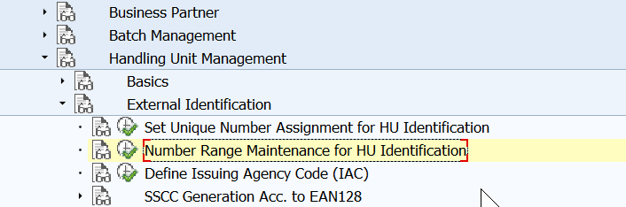
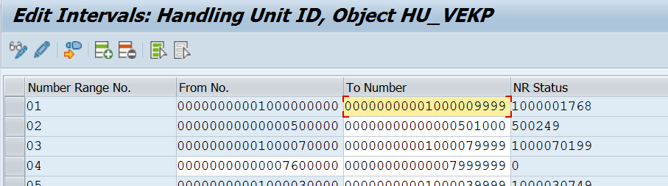
Define number range interval
www.anubhavtrainings.com

Slide 11
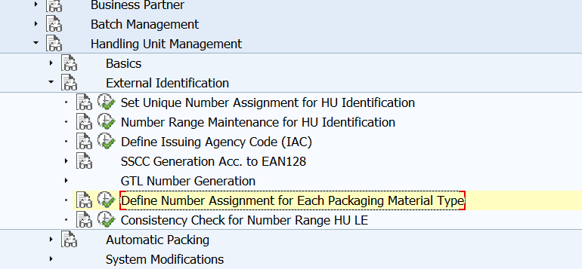
Assign Number range to Pack. Material grp
www.anubhavtrainings.com

Slide 12
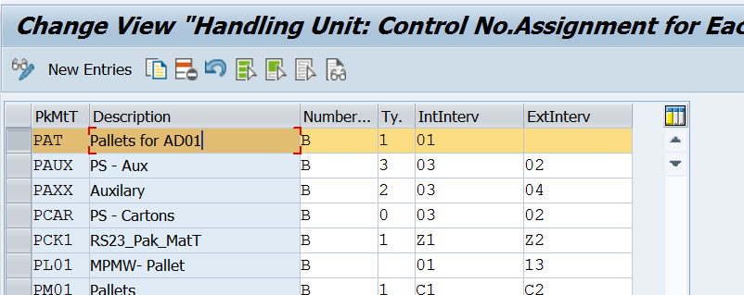
Note - Internal number in ERP side should be external in the EWM side. External NR in ERP should be Internal in EWM
HU Number configuration and HU numbers which are available to see in VL33N > document flow ……are required for HU Managed materials (or to have the HU functionality)
www.anubhavtrainings.com

Slide 13
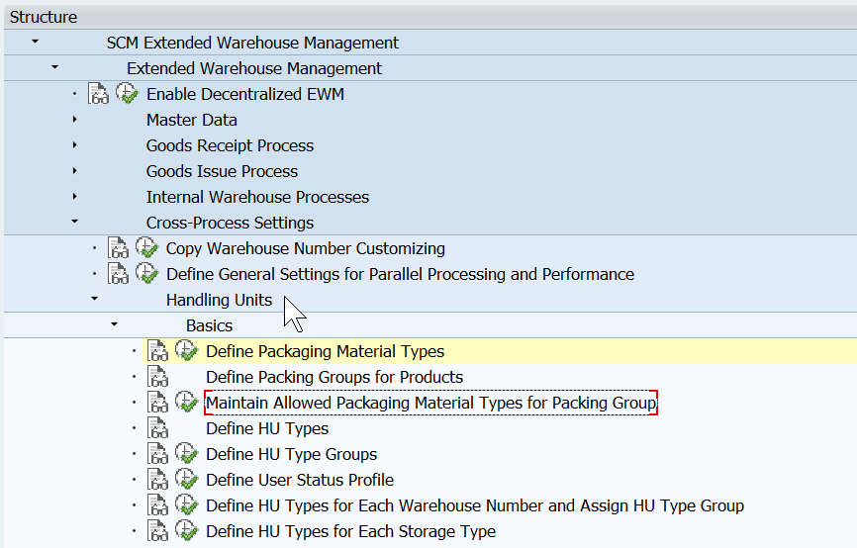
EWM side Configuration
SAP EWM help Portal (must visit for more details)
https://help.sap.com/docs/SAP_EXTENDED_WAREHOUSE_MANAGEMENT/3d97bec9bf1649099384bb8167df3cf2/570964b9-ac7f-4f33-8738-9e587238520e.html?version=9.5.0.0
Define packaging material type
www.anubhavtrainings.com

Slide 14
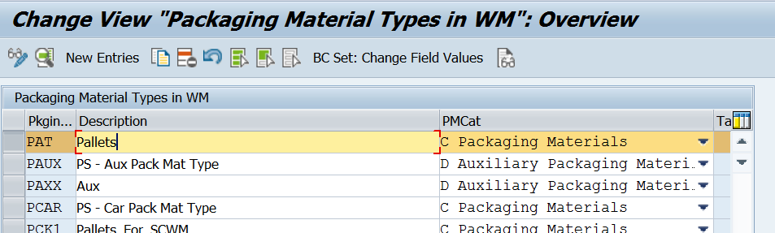
www.anubhavtrainings.com

Slide 15
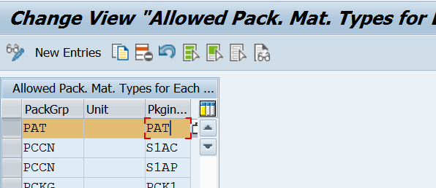
Maintain allowed packaging material type for packing group
Concept of this step is same as ERP side
www.anubhavtrainings.com

Slide 16
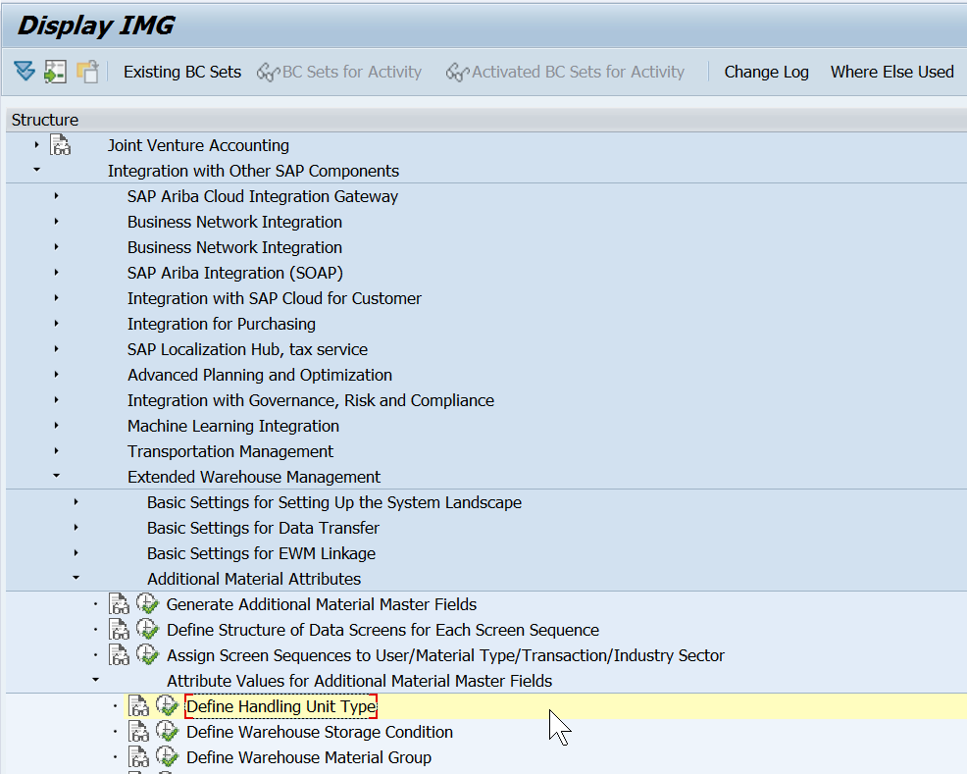
Define HU type
Describes the handling unit type of a packaging material, and replaces the storage unit type in Extended Warehouse Management.
SPRO > Integration with other SAP components > EWM > Additional material attributes > Attribute values for Additional Material master Fields > Define HU types
www.anubhavtrainings.com

Slide 17
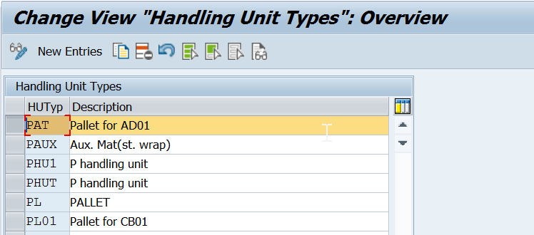
www.anubhavtrainings.com

Slide 18
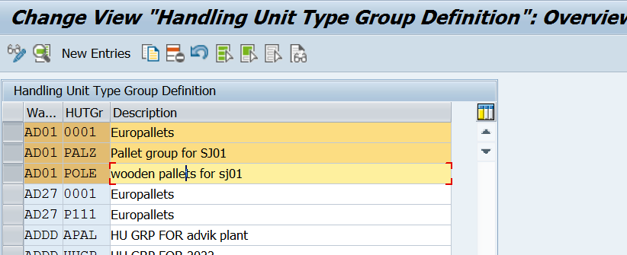
Define HU type
Groups handling unit types together according to their physical type.
E.g. HU Type group – Pallet
HU Type – Wooden pallet, Steel pallet, Normal pallet
www.anubhavtrainings.com

Slide 19
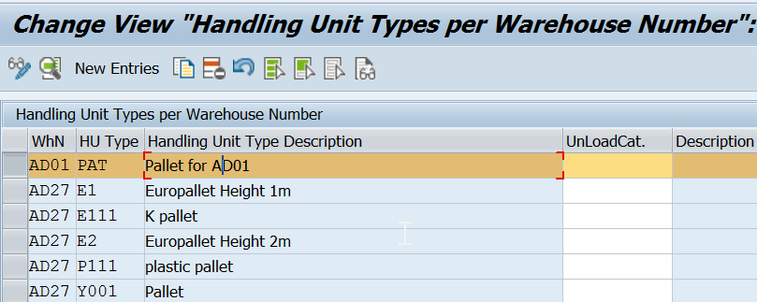
Define HU type for each warehouse number & assign HU type group (Same path)
www.anubhavtrainings.com

Slide 20
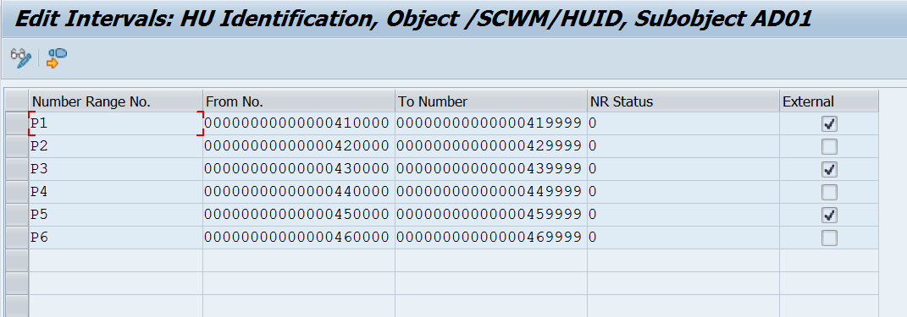
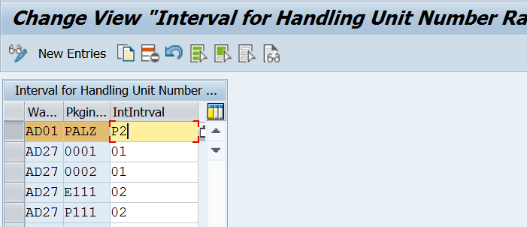
www.anubhavtrainings.com

Slide 21
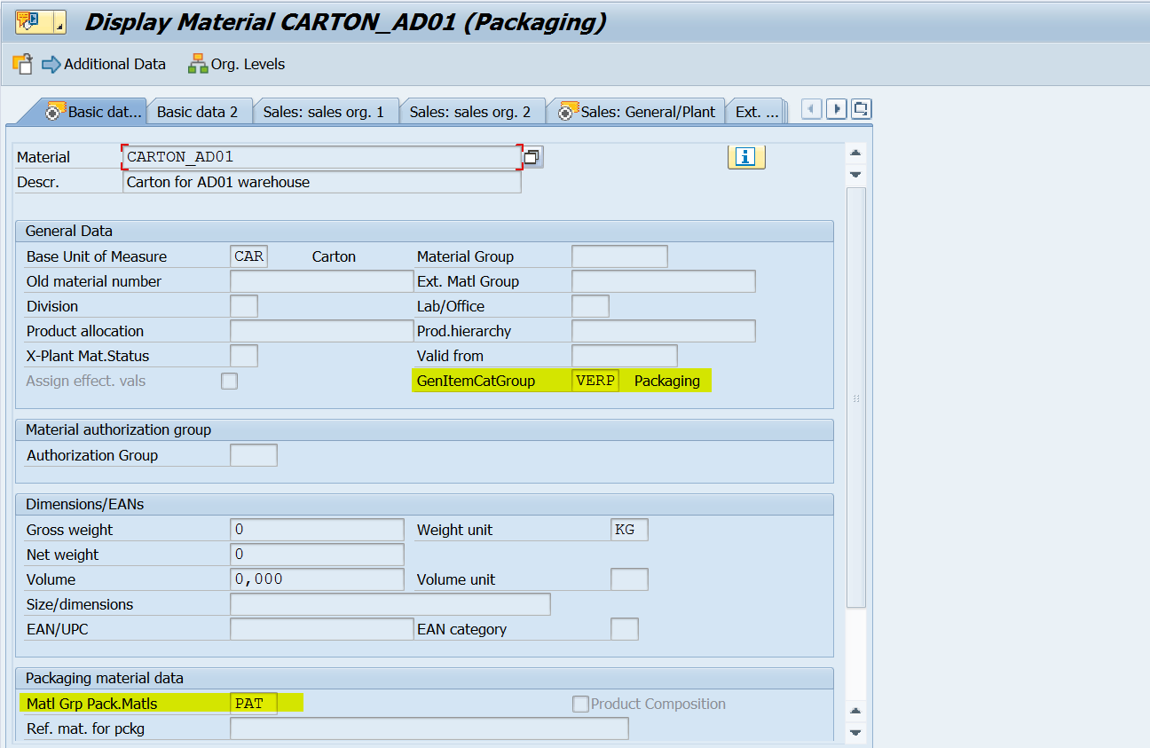
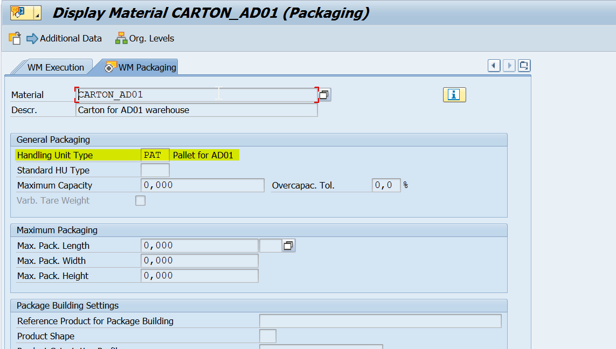
Create a Packaging Material (VERP) in ERP side MM01 (Basic data, Sales General data & WM packaging, WM Execution)
Assign Packing Group to Packaging Material type
www.anubhavtrainings.com

Slide 22


End of Session 04
www.anubhavtrainings.com

Slide 23

FEEL FREE TO ASK QUESTIONS

Slide 24

Feedback

Slide 25
THANK
YOU

Slide 26

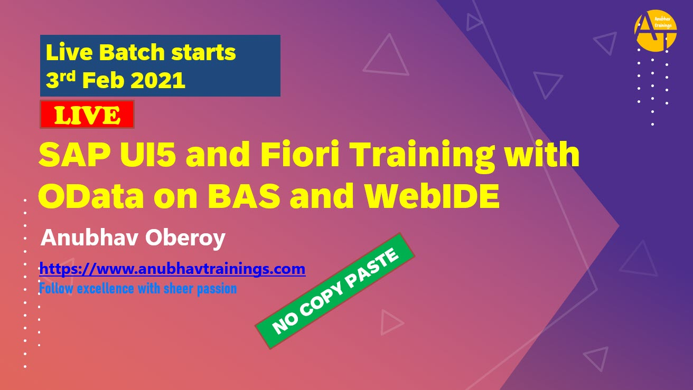

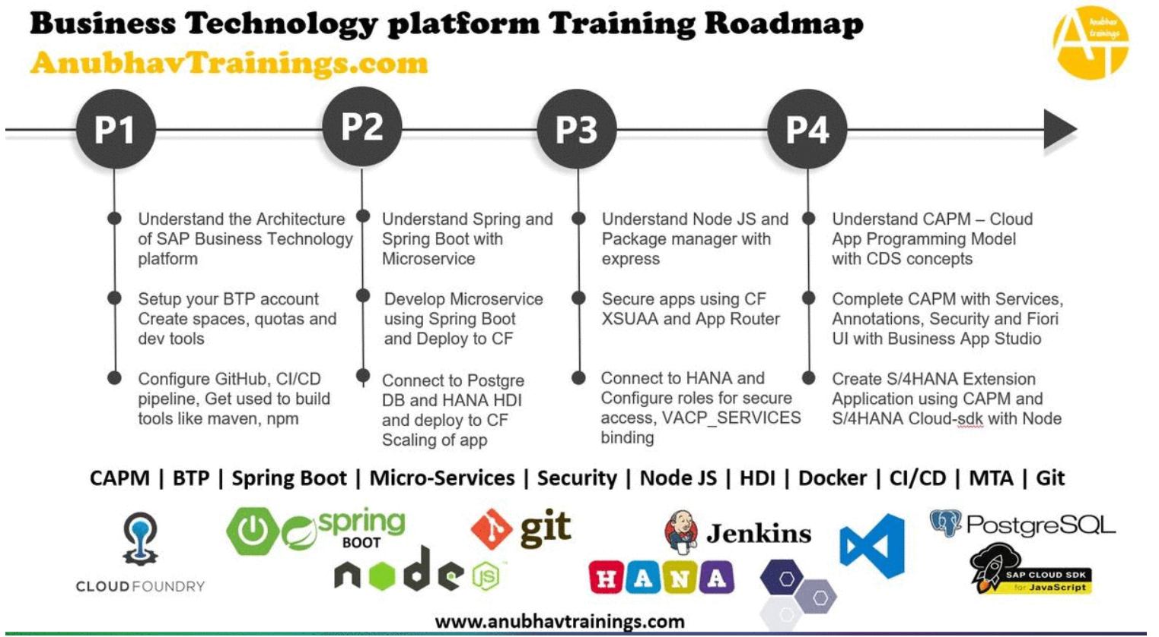
More from AnubhavTrainings.com

Slide 27






We’re committed to empower you to be
#FutureReady
through powerful training solutions.
We build the workforce of the future.
250+
Corporate Clients
30,000+
Learners Trained
25000+
Learners Placed
FREE WEBINARS
Sign up for free webinars with industry experts every fortnight!
Enroll Now!

Slide 28
FREE WEBINARS
Sign up for free webinars with industry experts every fortnight!
Contact us today!
www.anubhavtrainings.com

